Slide 1



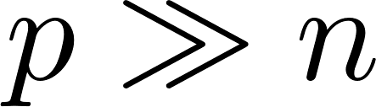
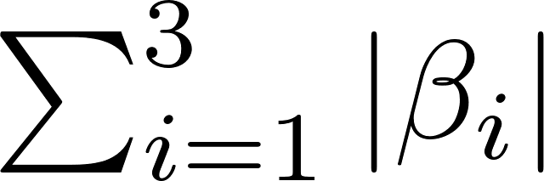
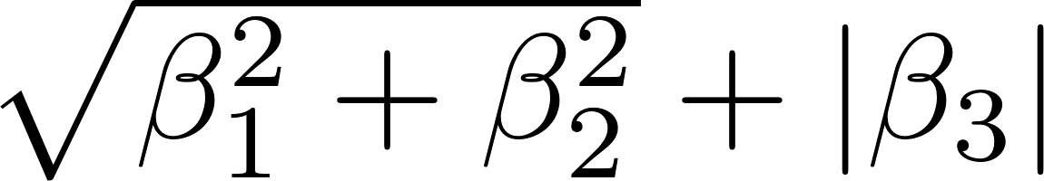
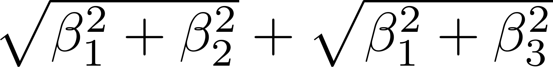


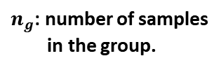









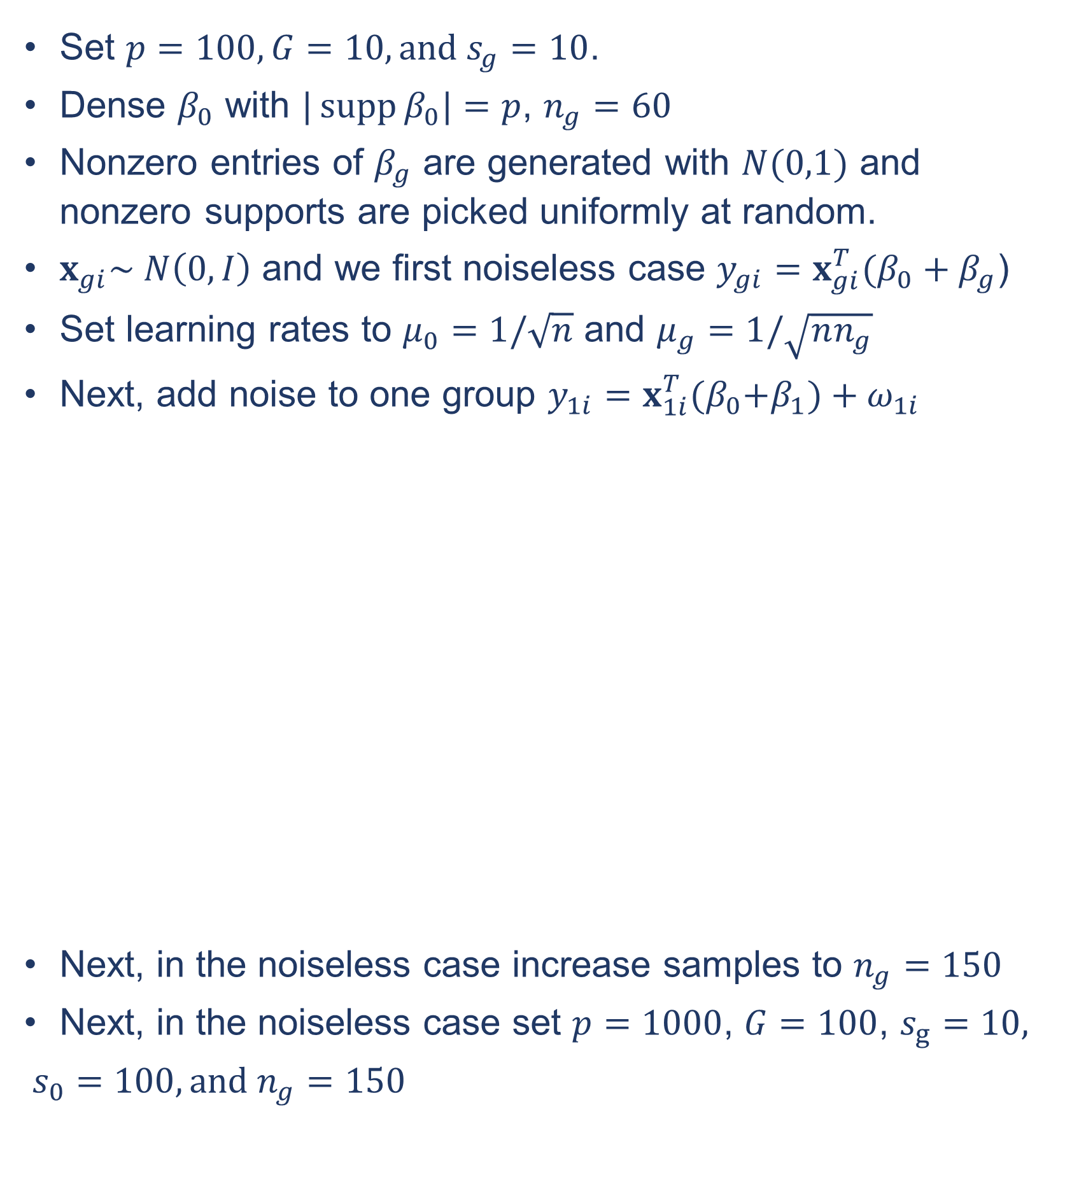


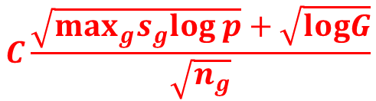


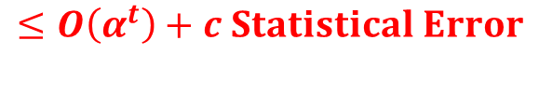


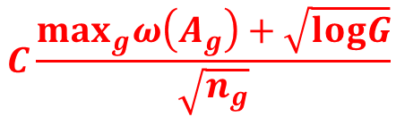



Data Enrichment: Multi-task Learning in High Dimension
with Theoretical Guarantees
Amir Asiaee
Samet Oymak
Kevin R. Coombes
Arindam Banerjee
Ohio State University
UC Riverside
Ohio State University
University of Minnesota
Motivation
Statistical Guarantees
Synthetic Experiment
How different sub-type of a cancer respond to a treatment?
What predictors are important in each group?
DERIC: Geometric Condition for Recovery
Statistical Questions:
Sample Complexity: How many samples are necessary in each class to recover the true parameters?
Error bound: What is the upper bound of estimation error?
General Case:
Sparsity Example:
Set $p=100, G=10, and s_{g}=10$.
Dense $β_{0}$ with $|\operatorname{supp}{β_{0}|=p}$, $n_{g}=60$
Nonzero entries of $β_{g}$ are generated with $N(0,1)$ and nonzero supports are picked uniformly at random.
$x_{gi}\sim N\left(0, I\right)$ and we first noiseless case $y_{gi}=x_{gi}^{T}({β_{0}+β}_{g}$)
Set learning rates to $μ_{0}=1/\sqrt{n}$ and $μ_{g}=1/\sqrt{nn_{g}}$
Next, add noise to one group $y_{1i}=x_{1i}^{T}{{(β}_{0}+β}_{1})+ω_{1i}$
Next, in the noiseless case increase samples to $n_{g}=150$
Next, in the noiseless case set $p=1000$, $G=100$, $s_{g}=10,$
$s_{0}=100, and n_{g}=150$
Input:
To satisfy the Restricted Eigenvalue condition, we need parameters to satisfy a geometric condition:
f₁
f₂
….
f_{p}
patient₁
Sub-type 1
$$X_{1}$$
….
….
….
estimation is impossible
estimation is impossible
Sub-type G
$$X_{G}$$
$$\left\|\hat{β_{g}}−β_{g}^{∗}\right\|$$
$$C\frac{max_{g}ω\left(A_{g}\right)+\sqrt{logG}}{\sqrt{n_{g}}}$$
$$\left\|\hat{β_{0}}−β_{0}^{∗}\right\|$$
$$C\frac{max_{g}ω\left(A_{g}\right)+\sqrt{logG}}{\sqrt{\sum_{g=1}^{G}{n_{g}}}}$$
patient_{n}
Estimation error
Estimation error
Output:
Predicting cell line response to treatment.
Determining the set of important features for response f_{i} s
$$m_{g}=O\left(ω{\left(A_{g}\right)}^{2}\right)$$
$n_{g}$: number of samples
in the group.
$$m_{0}=O\left(ω{\left(A_{0}\right)}^{2}\right)$$
$n$: total number of
samples
Introduction
estimation is impossible
estimation is impossible
Regression on a fixed number of pre-specified groups G.
Middle ground between two extremes
Individual per-group regression:
One overall-group regression:
The regression coefficients may vary sparsely between groups.
Parameter = shared component + individual per group component
Efficiently learn the shared component from the pooled data.
Learn individual parameters for each group.
High dimensional setting:
Parameters are structured [2, 5, 6], e.g., norms.
$$\left\|\hat{β_{g}}−β_{g}^{∗}\right\|$$
$$C\frac{\sqrt{max_{g}s_{g}log p}+\sqrt{logG}}{\sqrt{n_{g}}}$$
$$\left\|\hat{β_{0}}−β_{0}^{∗}\right\|$$
$$C\frac{\sqrt{max_{g}s_{g}log p}+\sqrt{logG}}{\sqrt{\sum_{g=1}^{G}{n_{g}}}}$$
Estimation error
Estimation error
$$m_{g}=O\left(s_{g}logp\right)$$
$n_{g}$: number of samples
in the group.
$$m_{0}=O\left(s_{0}logp\right)$$
$n$: total number of
samples
Optimization Algorithm
Computational Guarantees
Projected gradient descent: with clever step sizes
Projection can be computed efficiently in many cases [3, 4]
Computational Question:
Convergence rate analysis: How fast is the proposed algorithm?
For clever step sizes, it is very fast!
Converging to Statistical error:
References
[1] Asiaee, A., Oymak S., Coombes, K. R., Banerjee, A., "High dimensional data enrichment: interpretable, fast, data-efficient", ArXiv Preprint ArXiv:1806.04047.
[2] Chandrasekaran, V., et al. "The convex geometry of linear inverse problems." Foundations of Computational mathematics 12.6, 2012: 805-849.
[3] Duchi, J., Shalev-Shwartz, S., Singer, Y. , and Chandra, T., "Efficient projections onto the l 1-ball for learning in high dimensions." In Proceedings of the 25th international conference on Machine learning, pp. 272-279. , 2008.
[4] Parikh, N., and Boyd S., "Proximal algorithms." Foundations and Trends® in Optimization 1.3 (2014): 127-239.
[5] Vershynin, R., "Estimation in high dimensions: a geometric perspective." Sampling theory, a renaissance, 2015: 3-66
[6] Wainwright, M., "Structured regularizers for high-dimensional problems: Statistical and computational issues", Annual Review of Statistics and Its Application, 2014: 233-253
The Data Enrichment Estimator
$$β^{t}$$
$$β^{t−1}$$
A compact form of our proposed DE estimator is:
where:
Optimization Error
…..
$$β^{2}$$
$$β^{1}$$
$$\hat{β}$$
Statistical Error
Optimization Error
$$\hat{β}$$
$$β^{∗}$$
$$β^{t}$$
Acknowledgements
Statistical Error
$$≤O\left(α^{t}\right)+c Statistical Error$$
The research was supported by NSF grants IIS-1447566, IIS-1422557, CCF-1451986, CNS-1314560, IIS-0953274, IIS-1029711, and by NASA grant NNX12AQ39A.
$$β^{∗}$$

